Slide 1
Three Temporal Difference Learning Algorithms
Scott O’Hara
Metrowest Developers Machine Learning Group
7/8/2020

Slide 2
References
Sample-based Learning Methods (M. White and A. White), University of Alberta, Alberta Machine Intelligence Institute, Coursera.
https://www.coursera.org/learn/sample-based-learning-methods/
Reinforcement learning: An Introduction R. S. Sutton and A. G. Barto, Second edition. Cambridge, Massachusetts: The MIT Press, 2018.
Reinforcement Learning David Silver - University College London / Google DeepMind, 2015.
https://www.davidsilver.uk/teaching/

Slide 3
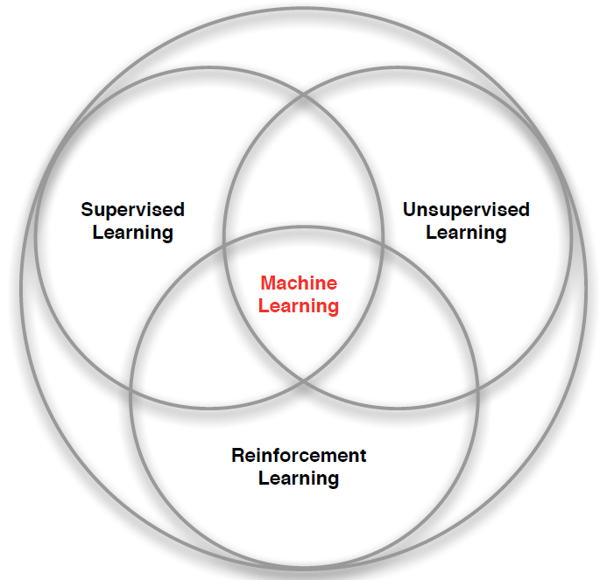
What is Reinforcement Learning?
“Reinforcement learning is a kind of unsupervised supervised learning”
– Rich Sutton
Supervised Learning – Learn a function from labeled data that maps input attributes to an output.
Unsupervised Learning – Find classes, patterns or generalizations in unlabeled data.
Reinforcement Learning –An agent learns to maximize rewards while acting in an uncertain environment.
Credit: image borrowed from lecture slides David Silver, DeepMind, “Introduction to Reinforcement Learning

Slide 4

The Reinforcement Learning Problem
Agent
State: s’
Reward: r
Actions: a
Environment
Agent must learn to act to maximize expected rewards.
Agent knows the current state s, takes an action a, receives a reward r and observes the next state s’.
$S_{0}, A_{0}, R_{0},S_{1}, A_{1}, R_{2},S_{2}, A_{2}, R_{2},…,S_{n}, A_{n}, R_{n},S_{T}$
Agent has no access to the reward model r(s,a,s’) or the transition model T(s,a,s’).

Slide 5
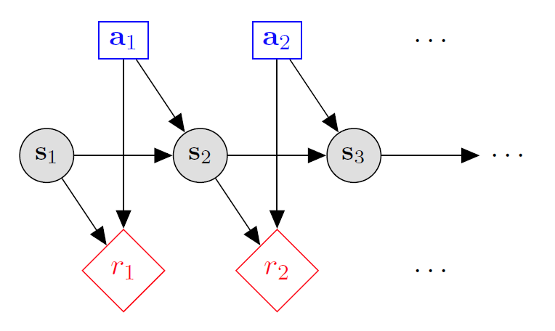

Markov decision processes
States: $s_{1},…,s_{n}$
Actions: $a_{1},…,a_{m}$
Reward model:
$R\left(s,a,s′\right)∈R$
Transition model:
$T\left(s,a,s′\right)=$ $P\left(s′ | s, a\right)$
Discount factor: $γ∈\left[0,1\right]$
<https://en.wikipedia.org/w/index.php?title=Markov_decision_process&oldid=855934986> [accessed 11 September 2018]

Slide 6
Quantities to optimize
The value (utility) of a state s:
V(s) = expected utility starting in s and acting optimally thereafter.
The value (utility) of a q-state (s,a):
Q(s,a) = expected utility when taking action a from state s and acting optimally thereafter.
The policy π:
π(a|s) = probability of action a from state s
s
s is a state
a
(s, a) is a q-state
s, a
s,a,s’
(s,a,s’) is a transition
s’
Credit: CS188 – Intro to AI, UC Berkeley, ai.berkely.edu
Notes:
Demo just shows V and Q values, snapshots on next slides.

Slide 7
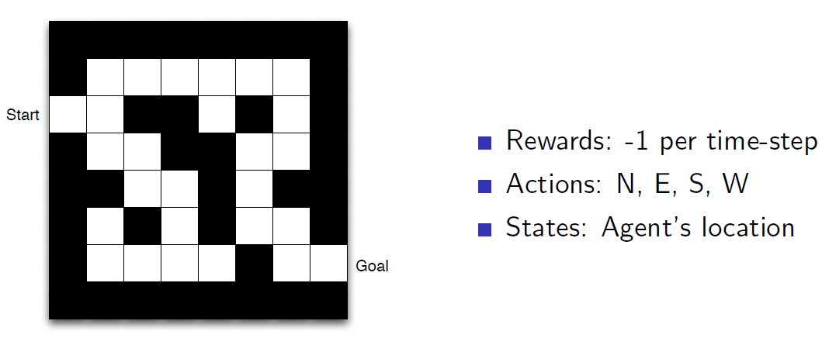
Maze Example
Credit: Reinforcement Learning, David Silver, University College London / Google DeepMind, 2015.

Slide 8
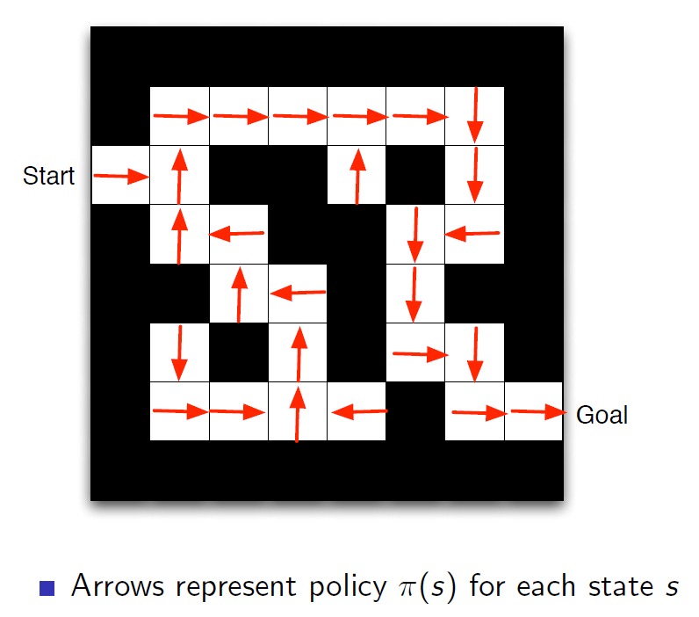
Maze Example: Policy
Credit: Reinforcement Learning, David Silver, University College London / Google DeepMind, 2015.

Slide 9
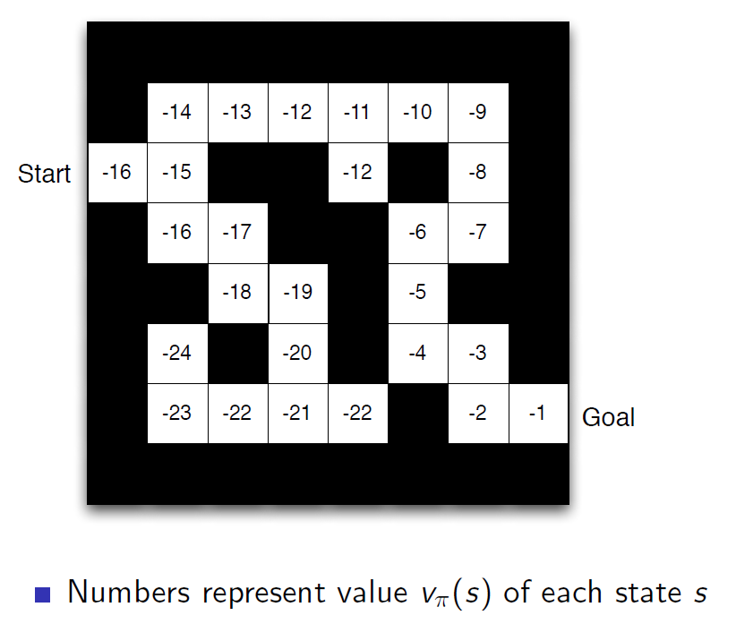
Maze Example: Value Function
Credit: Reinforcement Learning, David Silver, University College London / Google DeepMind, 2015.

Slide 10
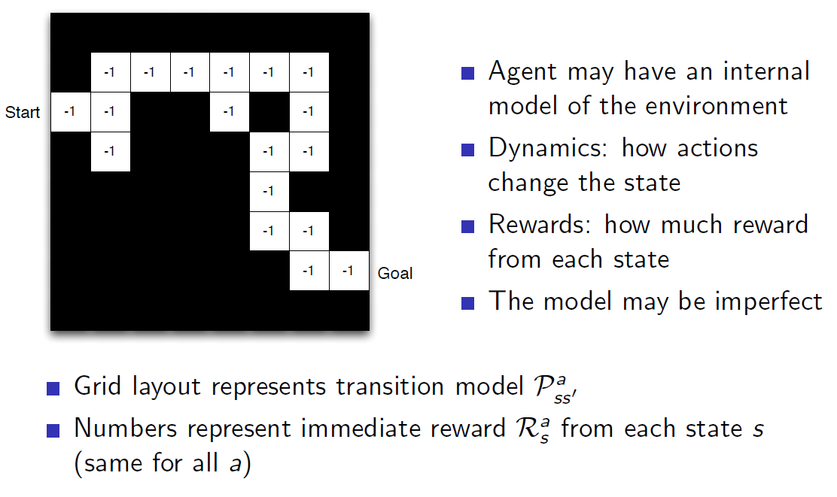
Maze Example: Model
Credit: Reinforcement Learning, David Silver, University College London / Google DeepMind, 2015.

Slide 11
What is Temporal Difference (TD) Learning?
TD-Learning is a kind of prediction learning that takes advantage of the temporal structure of learning to predict.
In prediction learning:
You make a prediction about what will happen next.
You wait to see what happens.
You learn by comparing what happens to what you predicted.
Credit: Sample-based Learning Methods (M. White and A. White), University of Alberta, Alberta Machine Intelligence Institute, Coursera.

Slide 12
What is Temporal Difference (TD) Learning?
TD-Learning is one of the most fundamental ideas in reinforcement learning.
From Reinforcement Learning: An Introduction: “If one had to identify one idea as central and novel to reinforce learning, it would be temporal difference learning.” (page 119, Chapter 6)
Credit: Sample-based Learning Methods (M. White and A. White), University of Alberta, Alberta Machine Intelligence Institute, Coursera.

Slide 13

Updating from a Prediction
The Future
(The TD-target)
The Present
(The TD-prediction)
Credit: Sample-based Learning Methods (M. White and A. White), University of Alberta, Alberta Machine Intelligence Institute, Coursera.

Slide 14
$$S_{0}, A_{0}, R_{1},S_{1}, A_{1}, R_{2},S_{2},…,S_{t}, A_{t}, R_{t+1},S_{t+1}$$
R_{T+1}
A_{T}
Updating from a Prediction
. . .
. . .
S_{t}
S_{t+1}
V(S_{T})
γV(S_{T+1})

Slide 15
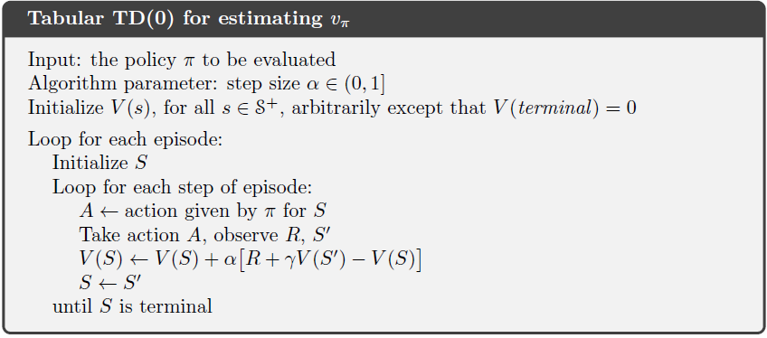

TD Learning: Value Prediction

Slide 16
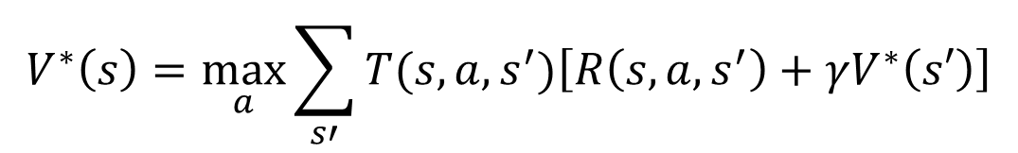
Prediction vs Control
Unfortunately, the TD Value Estimation algorithm will only allow you to predict the value you will get from being in a given state.
BUT, unless you have a model of the environment, it does not allow you to determine a policy to control the agent to maximize the value in the environment.
Update Rule:
$$V^{∗}\left(s\right)=\max_{a}\sum_{s′}{T(s,a,s^{′})\left[R\left(s,a,s^{′}\right)+γV^{∗}\left(s′\right)\right]}$$
Bellman Eq:

Slide 17

Prediction vs Control (2)
Fortunately, if you learn the state-action value function Q, you can both predict the value of an action at a given state AND you can control the agent to maximize the value in the environment.
Update Rule:
$$Q_{k}\left(s,a\right)←Q_{k}\left(s,a\right)+α\left[r+γQ_{k}\left(s′,a′\right)−Q_{k}\left(s,a\right)\right]$$
Bellman Eq:

Slide 18
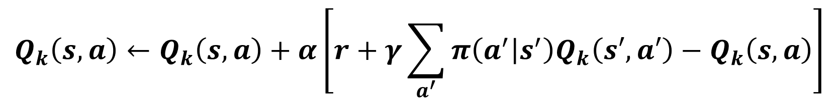
3 Update rules, 3 Algorithms
Sarsa:
$$Q_{k}\left(s,a\right)←Q_{k}\left(s,a\right)+α\left[r+γQ_{k}\left(s′,a′\right)−Q_{k}\left(s,a\right)\right]$$
Q-Learning:
$$Q_{k}\left(s,a\right)←Q_{k}\left(s,a\right)+α\left[r+γ\max_{a′}{Q_{k}\left(s′,a′\right)}−Q_{k}\left(s,a\right)\right]$$
Expected Sarsa:
$$Q_{k}\left(s,a\right)←Q_{k}\left(s,a\right)+α\left[r+γ\sum_{a^{′}}{π\left(a^{′} | s^{′}\right)Q_{k}\left(s′,a′\right)}−Q_{k}\left(s,a\right)\right]$$

Slide 19
Classifying RL Algorithms
Prediction:
Predict the value of a state or a state-action pair.
How does the algorithm compute the value functions V and Q?
Control:
How does algorithm decide what to do next?
How is the agent’s policy created and optimized?
Exploitation vs. exploration strategies.
Planning:
Does the algorithm use a model of the environment?
How is the model created and updated?
How is the model exploited?

Slide 20
On-Policy / Off-Policy Model-based / Model-Free
Control:
On-policy – learn policy based on the one you are following.
Off-policy – learn policy different from the one you are following.
Planning:
Model-based – use a model of the environment for prediction and control.
Model-free – learn value function or policy directly without a model i.e., the transition function and the reward function. Sarsa, Q-learning and Expected Sarsa are all model-free.

Slide 21
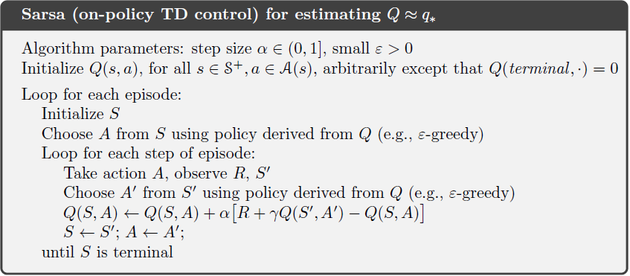

SARSA – On-policy TD Control

Slide 22
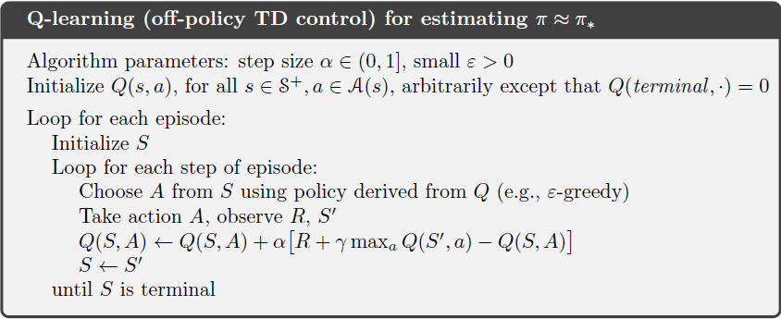
Q-learning – Off-policy TD Control

Slide 23
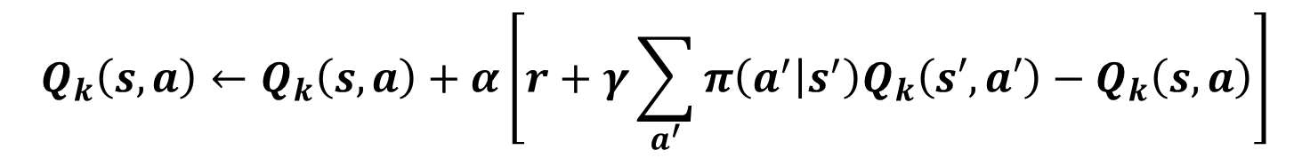
Expected SARSA – On-policy TD Control
Same as Q-Learning, but substitute expected state-action value for the max state-action value.
$$Q_{k}\left(s,a\right)←Q_{k}\left(s,a\right)+α\left[r+γ\sum_{a^{′}}{π\left(a^{′} | s^{′}\right)Q_{k}\left(s′,a′\right)}−Q_{k}\left(s,a\right)\right]$$

Slide 24
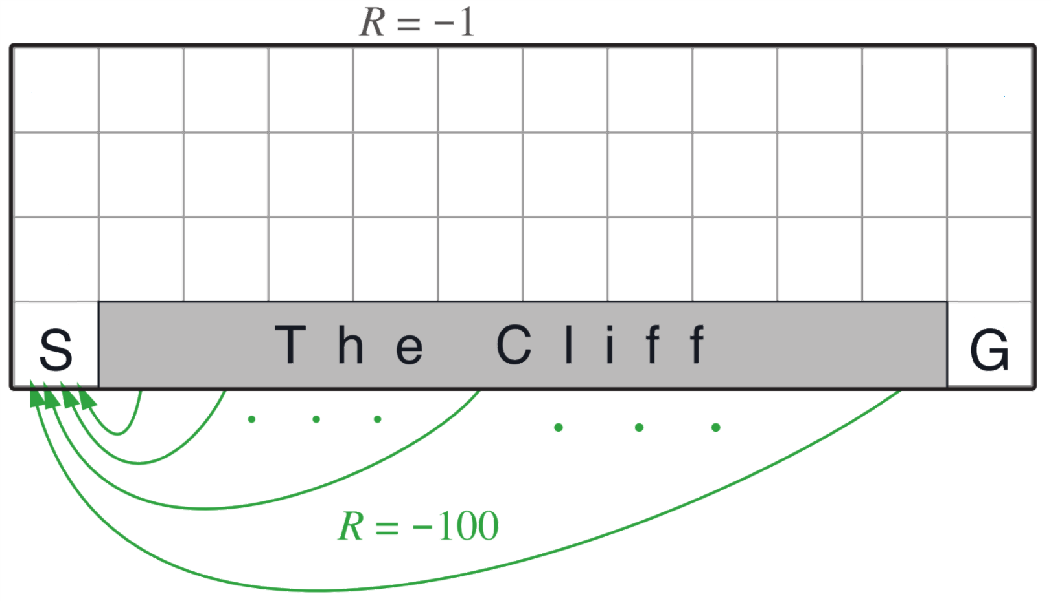
RL Environment: Cliffworld
States: <x, y> locations
Actions: move north, south, east or west.
Reward model:
0 if robot moves to the goal state G where episode finishes.
-100 if robot moves to the cliff.
-1 for every other move.
Transition model:
Robot moves deterministically in the chosen direction: north, south, east or west.
Robot stays put if it moves into a wall.
Robot transitions to the start state if it moves onto the cliff. (NOTE: episode does not finish.)
Discount factor: γ = 1.0
Credit: Sample-based Learning Methods (M. White and A. White), University of Alberta, Alberta Machine Intelligence Institute, Coursera.

Slide 25
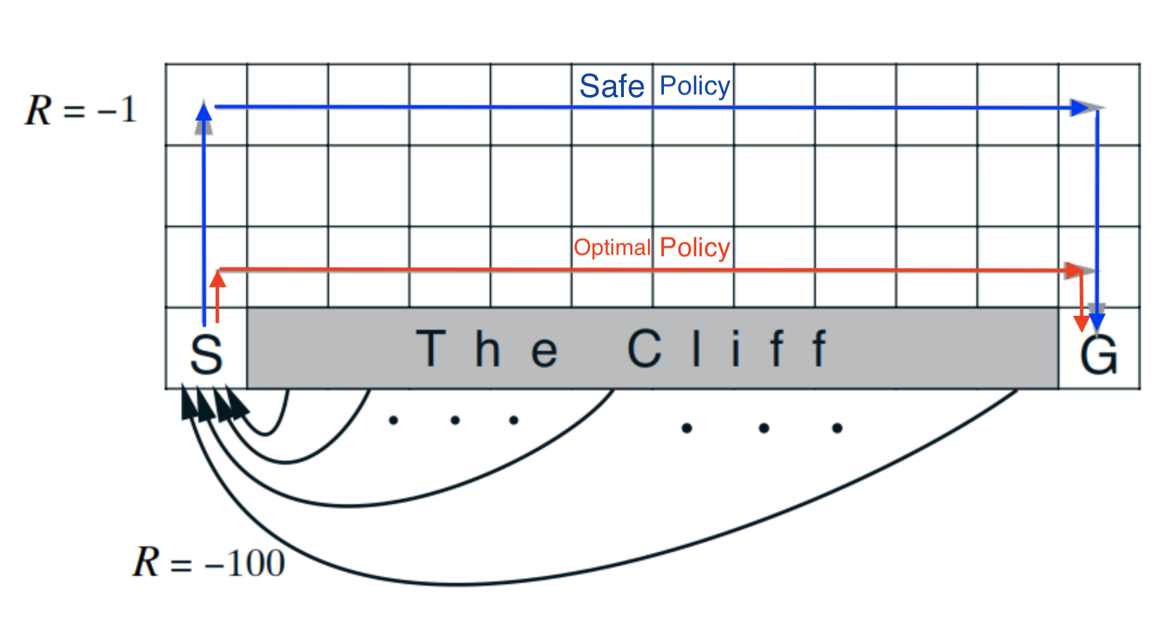
Q-learning: Optimal Vs. “Safe” Policies
Q-learning will learn the optimal policy.
However, q-learning must stop exploring and change to complete exploitation mode to take advantage of this.
If q-learning continues to explore (off-policy), it will often get bad results since exploration will lead it to step over the cliff.
Credit: Sample-based Learning Methods (M. White and A. White), University of Alberta, Alberta Machine Intelligence Institute, Coursera.

Slide 26
SARSA: Optimal Vs. “Safe” Policies
SARSA will learn the safe policy since it learns the policy it actually does.
However, SARSA learns slowly since it doesn’t take full advantage of the knowledge it has of state-action values.
Credit: Sample-based Learning Methods (M. White and A. White), University of Alberta, Alberta Machine Intelligence Institute, Coursera.

Slide 27
Expected SARSA: Optimal Vs. “Safe” Policies
Is it possible to learn an optimal policy that allows the agent to continue exploring?
Yes! Expected SARSA, which is an on-policy algorithm can take into consideration the probability that an exploration action will take it over the cliff.
Downside: It is more expensive to compute this policy.
Credit: Sample-based Learning Methods (M. White and A. White), University of Alberta, Alberta Machine Intelligence Institute, Coursera.

Slide 28
choosing an action: exploration vs exploitation
How should an agent choose an action? An obvious answer is simply to follow the current policy. However, this is often not the best way to improve your model.
Exploit: use your current model to maximize the expected utility now.
Explore: choose an action that will help you improve your model.

Slide 29

Expected SARSA with ϵ-Greedy Method
$n \text{− }\text{number} \text{of} \text{actions}$
$m \text{− }\text{number} \text{of} \text{max} \text{actions}$
With probability 1 - ϵ:
select the action with the maximum value.
$$A_{t}=argmax Q_{t}(a)$$
$$P\left(a_{max}\right)=\frac{\left(1−ε\right)}{m}+\frac{ε}{n}$$
With probability ϵ:
randomly select an action from all the
actions with equal probability.
$P\left(a_{other}\right)=\frac{ε}{n}$

Slide 30
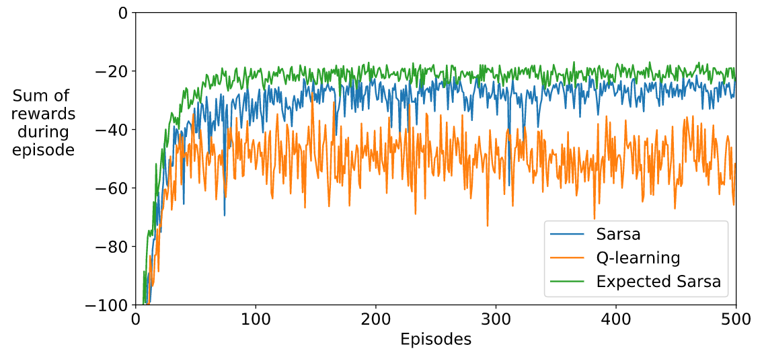
SARSA vs. Q-Learning vs. Expected SARSA
100 runs / 500 episodes per run.
Average the sum of rewards for each episode over 100 runs.
Credit: Sample-based Learning Methods (M. White and A. White), University of Alberta, Alberta Machine Intelligence Institute, Coursera.

Slide 31
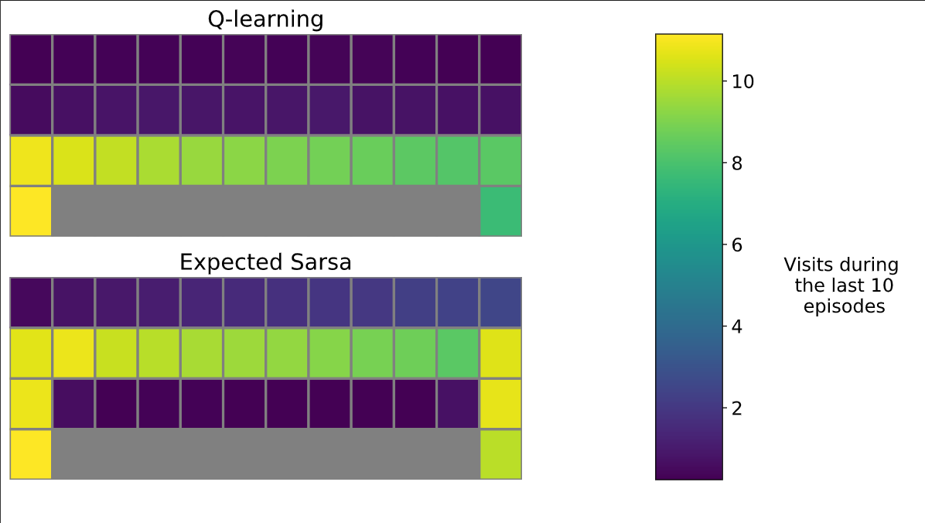
Q-Learning vs. Expected SARSA
100 runs / 500 episodes per run.
Average the number of visits to a state during the last 10 episodes over 100 runs.
Credit: Sample-based Learning Methods (M. White and A. White), University of Alberta, Alberta Machine Intelligence Institute, Coursera.

Slide 32
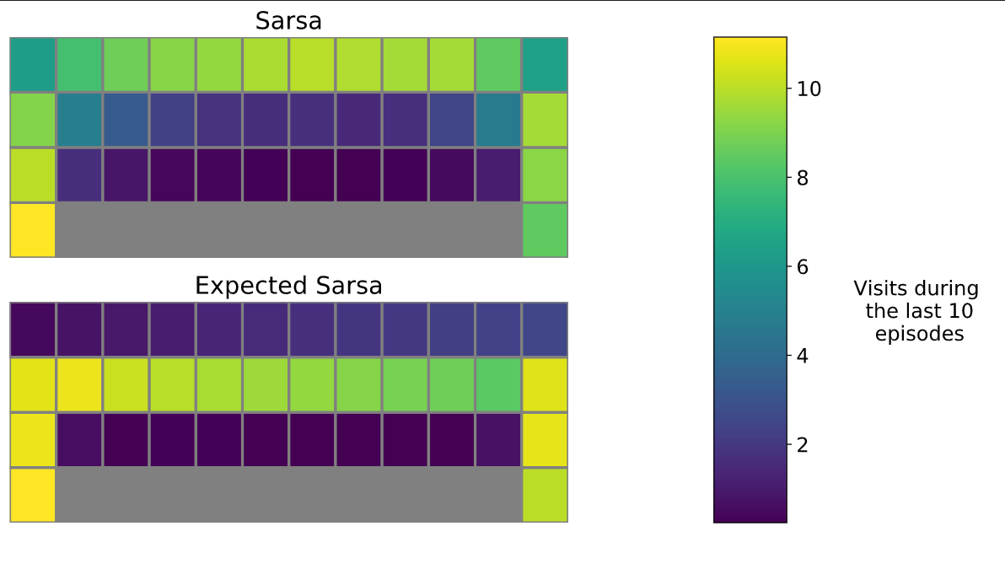
SARSA vs. Expected SARSA
100 runs / 500 episodes per run.
Average the number of visits to a state during the last 10 episodes over 100 runs.
Credit: Sample-based Learning Methods (M. White and A. White), University of Alberta, Alberta Machine Intelligence Institute, Coursera.

Slide 33
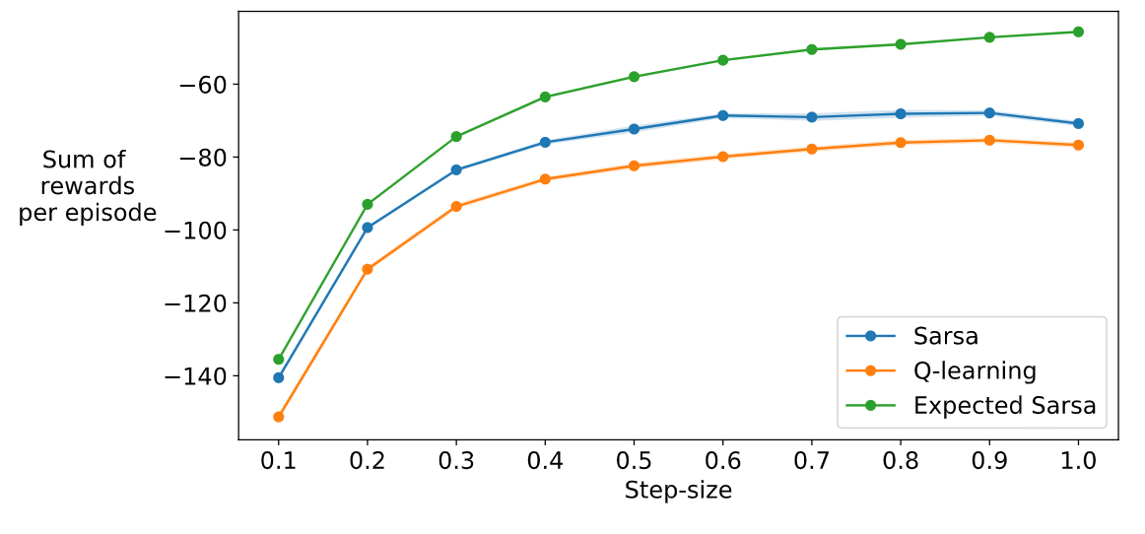
Step-Size: SARSA vs. Q-Learning vs. Expected SARSA
100 runs / 100 episodes per run.
Average the sum of rewards for each episode over 100 runs for each step-size.
Credit: Sample-based Learning Methods (M. White and A. White), University of Alberta, Alberta Machine Intelligence Institute, Coursera.

Slide 34
CONCLUSIONS
Q-Learning will learn the optimal policy for an MDP but cannot fully exploit it unless it stops exploring.
If q-learning continues to explore, the total value per episode will be sub-optimal.
Expected Sarsa can find an optimal policy for a blend of exploitation and exploration.
However, the computational overhead for Expected Sarsa is significant.
The Sarsa algorithm can “play it safe” since it learns the policy it actually carries out.

Slide 35
Three Temporal Difference Learning Algorithms
Scott O’Hara
Metrowest Developers Machine Learning Group
7/8/2020

